Slide 1
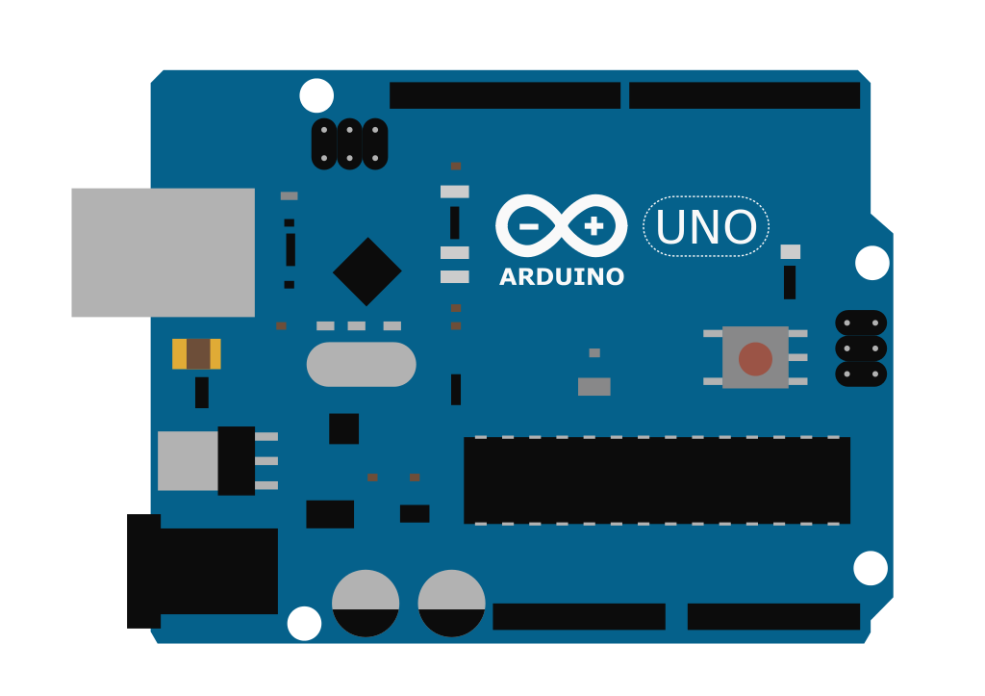
Smart Door System
ARDUINO COMPONENTS

Slide 2
Created by :
Abdelraouf Shinkada 192239
&
Abdulali Elmgalish 192118
Developed by :
Abdelraouf Shinkada
Under The Supervision of
Dr.Ahmed Al-Najah

Slide 3



العناصر المستخدمة في جزء الاردوينو (HARDWARE)
1
2
3
4
5
6
ARDUINO
BREAD BOARD & WIRES
SERVO MOTOR
IR SENSOR
DT-06 WIRELESS WIFI
RFID
7
8
LCD liquid crystal
BUZZER

Slide 4
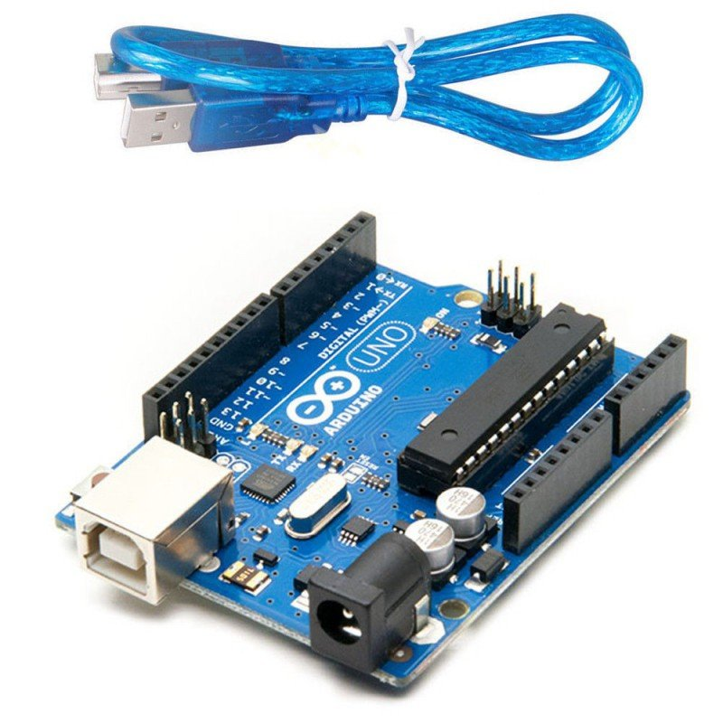
1
ARDUINO

Slide 5


Details of the first element: arduino
The following table shows the following information :
NAME | Arduino
TYPE | UNO
PIN MODE | -
INPUT \ OUTPUT | -

Slide 6
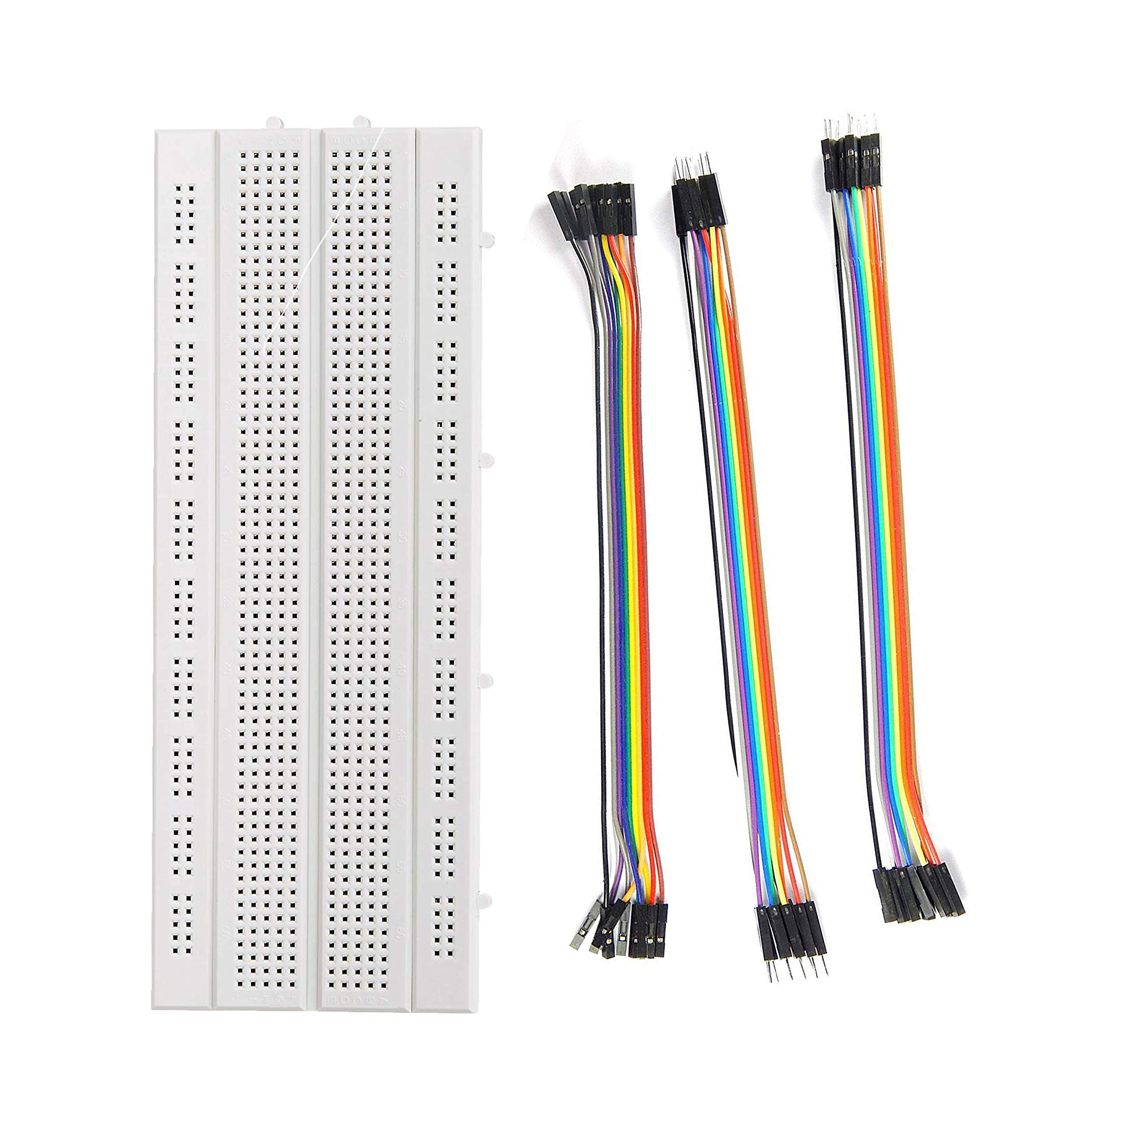
2
BREAD BOARD & WIRES

Slide 7


Details of the second element: bread board & wires
The following table shows the following information :
NAME | bread board & wires
TYPE | Protoboard & simple solid core wire
PIN MODE | -
INPUT \ OUTPUT | -

Slide 8
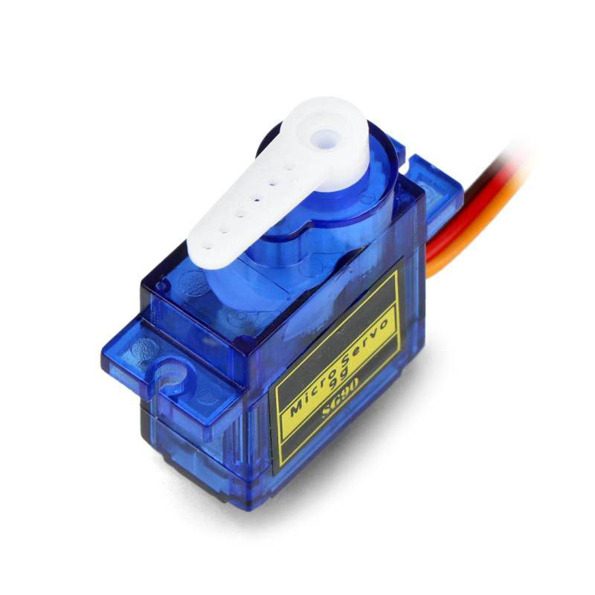
3
SERVO MOTOR

Slide 9
Details of the third element: servo motor
The following table shows the following information :
NAME | Servo motor
TYPE | PLASTIC
PIN MODE | 5
INPUT \ OUTPUT | OUTPUT

Slide 10
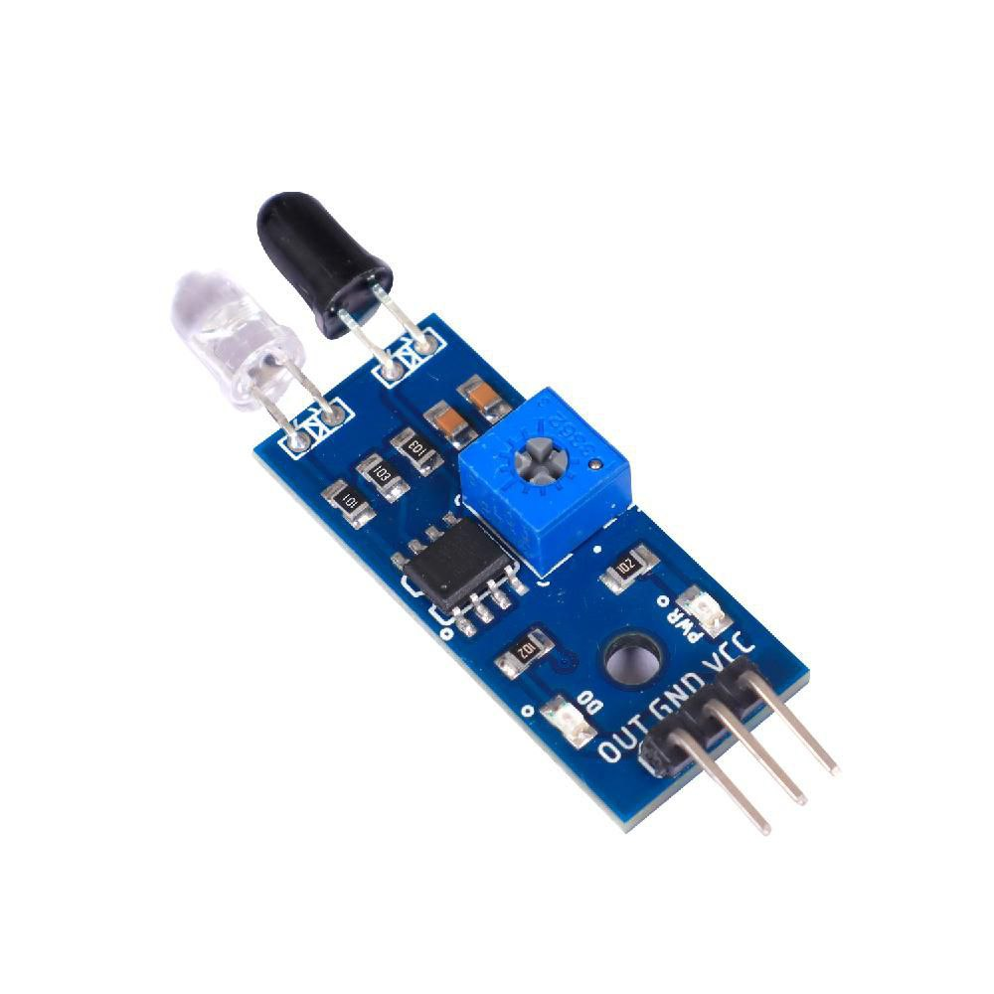
4
IR SENSOR

Slide 11
Details of the fourth element: ir sensor
The following table shows the following information :
NAME | IR Sensor
TYPE | ACTIVE LOW
PIN MODE | 2
INPUT \ OUTPUT | INPUT

Slide 12
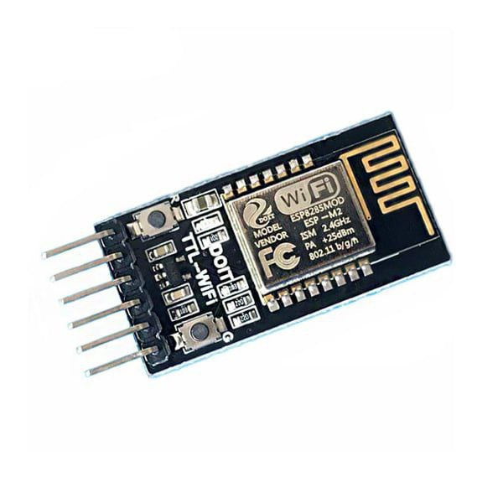
5
DT-06 WIRELESS WIFI

Slide 13
Details of the fifth element: DT-06 WIRELESS WIFI
The following table shows the following information :
NAME | DT-06 WIRELESS WIFI
TYPE | Wifi Module
PIN MODE | 5v,6,8,GND
INPUT \ OUTPUT | -

Slide 14
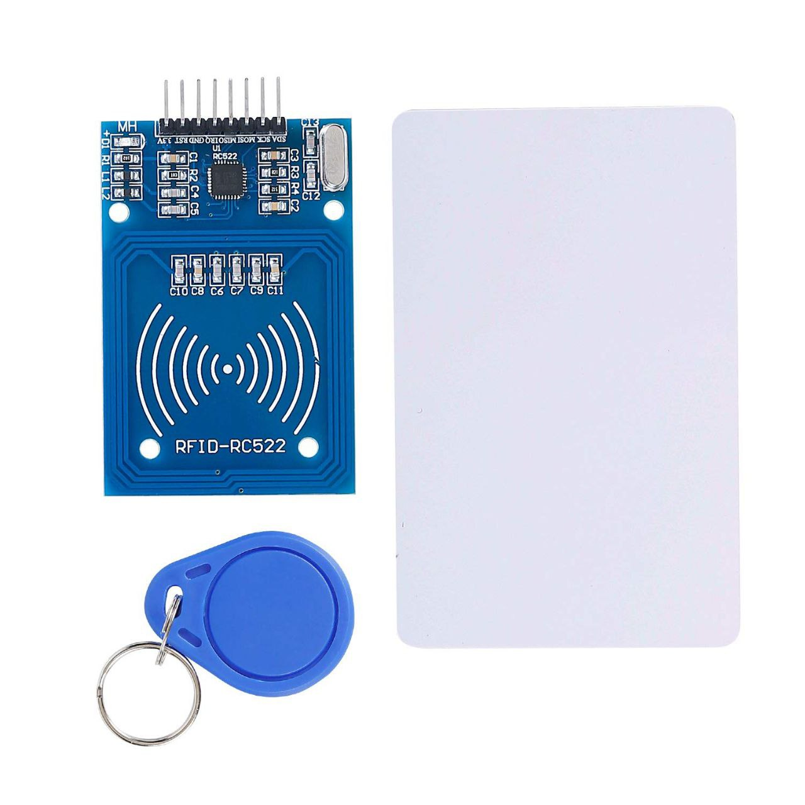
6
RFID

Slide 15
Details of the sixth element: RFID
The following table shows the following information :
NAME | rfid
TYPE | RC522
PIN MODE | 3.3V,9,10,11,12,13,GND
INPUT \ OUTPUT | INPUT

Slide 16
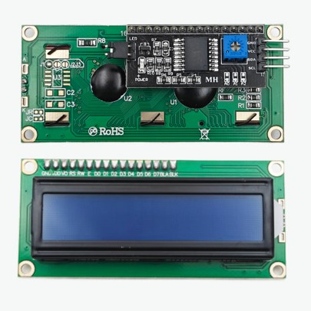
7
LCD liquid crystal

Slide 17
Details of the seventh element: LCD liquid crystal
The following table shows the following information :
NAME | Lcd liquid crystal
TYPE | i2c
PIN MODE | 5V,A4,A5,GND
INPUT \ OUTPUT | OUTPUT

Slide 18
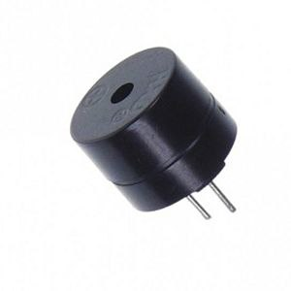
8
BUZZER

Slide 19
Details of the eighth element: buzzer
The following table shows the following information :
NAME | buzzer
TYPE | Active high
PIN MODE | 7,GND
INPUT \ OUTPUT | OUTPUT

Slide 20
THANKS
FOR
LISTENING

Slide 21
THANKS
FOR
LISTENING

Slide 22
THANKS FOR LISTENING

